Slide 1
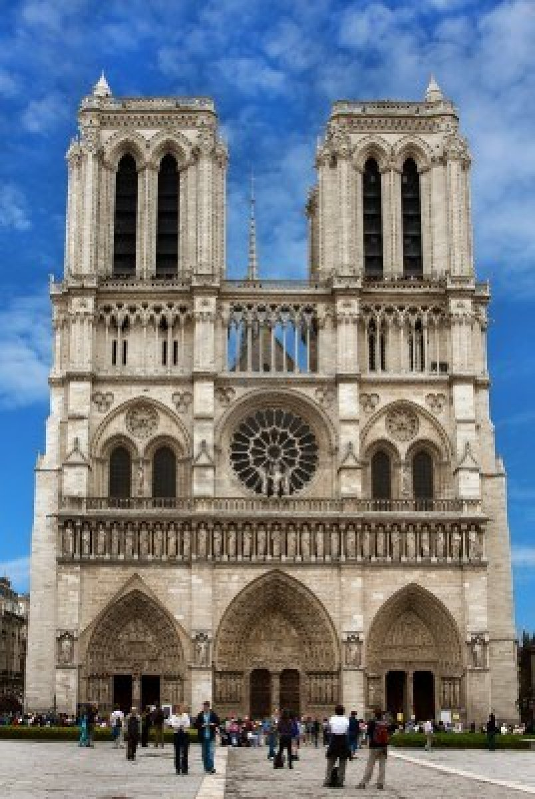
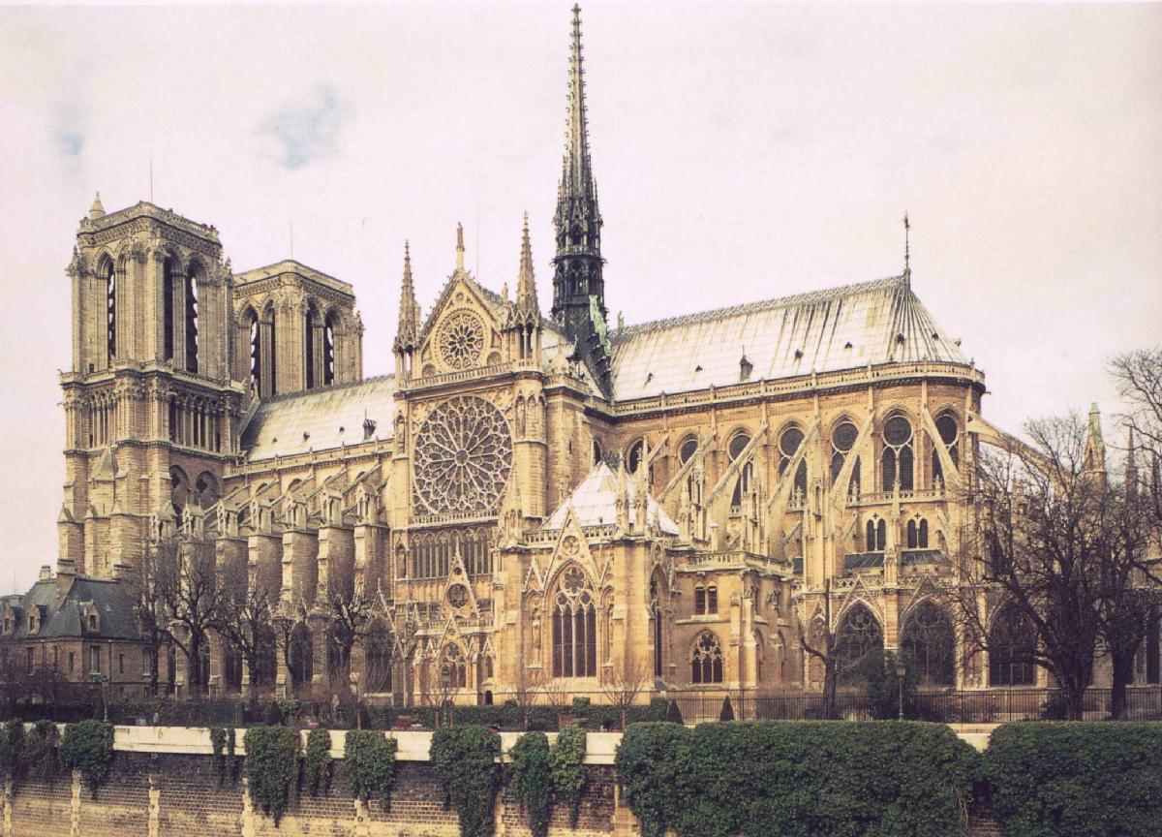
Notre Dame de Paris Cathédrale
By Leah M Hoffman. Nov. 12.13

Slide 2
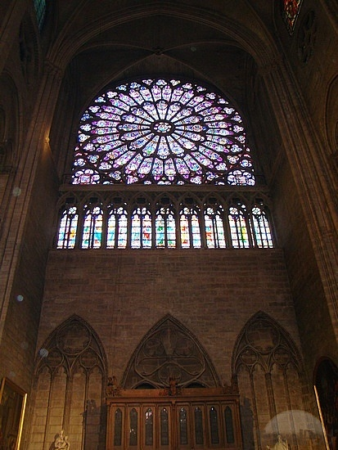
“The cathedral church must be seen as the centre of the diocese’s liturgical life. Love and veneration towards the cathedral church will be instilled in believers” -Notre Dame de Paris Cathédrale
Very Famous for their choir and organ use.
Gothic-Style Cathedral
(ogival style)
In Paris, France.
First stone laid in 1163 in Pope Alexander iii’s presence.
Modifications not done until early 19th century when restored

Slide 3
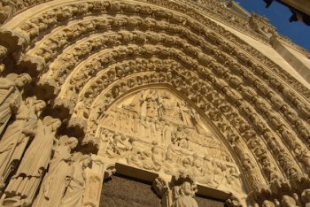
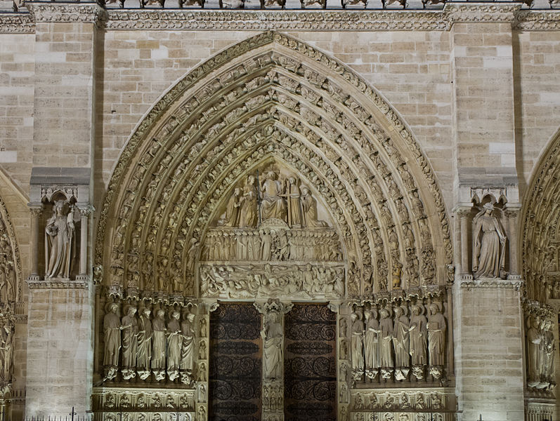
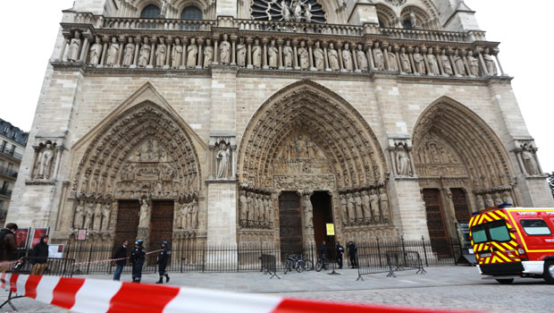
The Portal of the Last Judgement 12 Disciples
Don’t mind the crime scene <------------

Slide 4
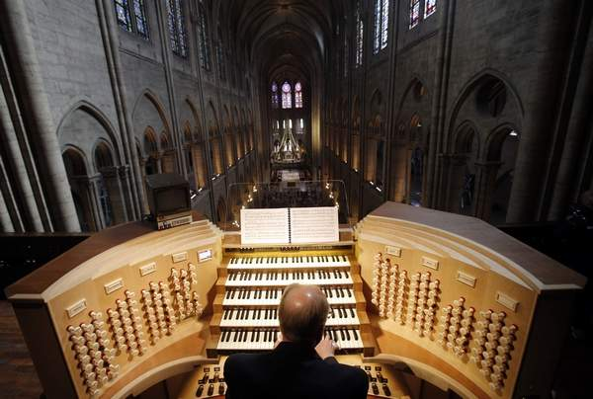
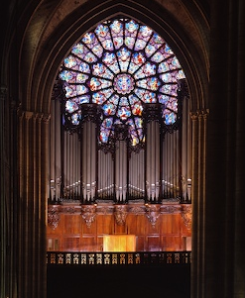
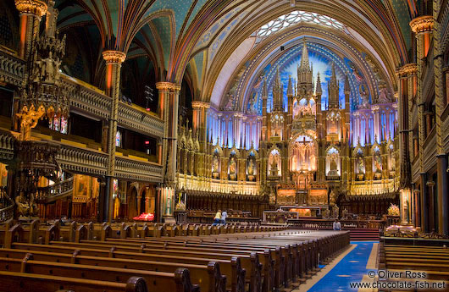
“They play a key role in the cathedral’s musical and liturgical life and contribute to the beauty of the services and to Notre-Dame de Paris’s spiritual and artistic influence.” -NDPC
There are 3 Piano’s:
-The Great Organ
-The Choir Organ
-The Positive Organ

Slide 5
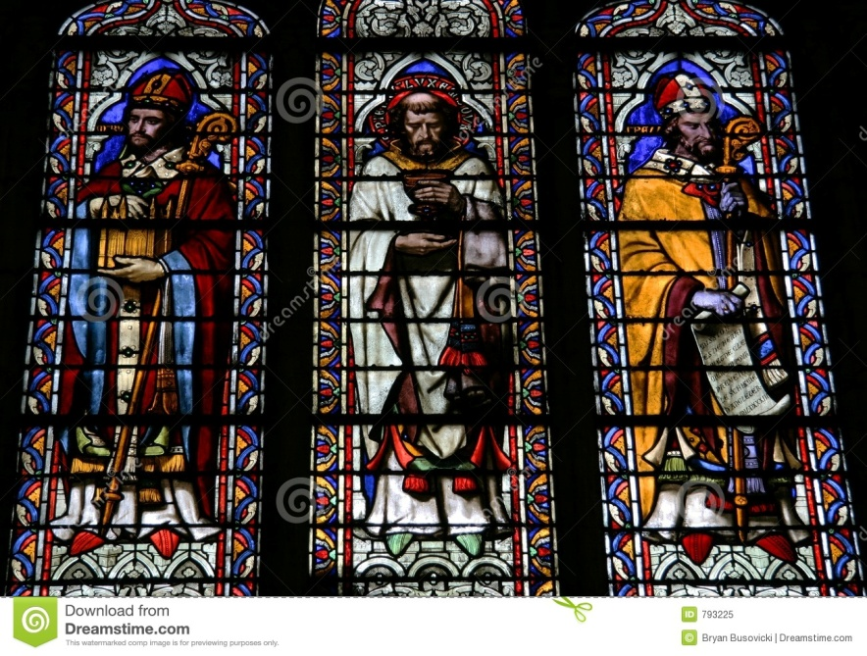
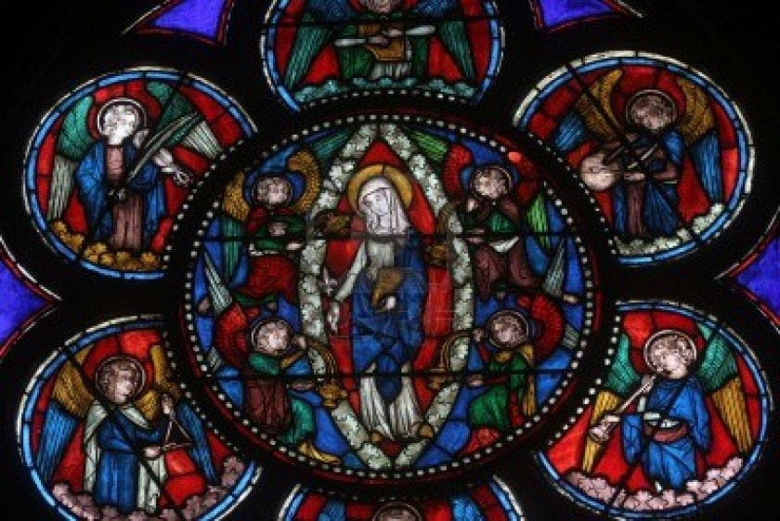
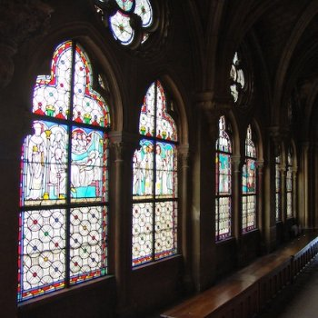
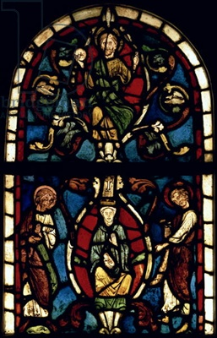
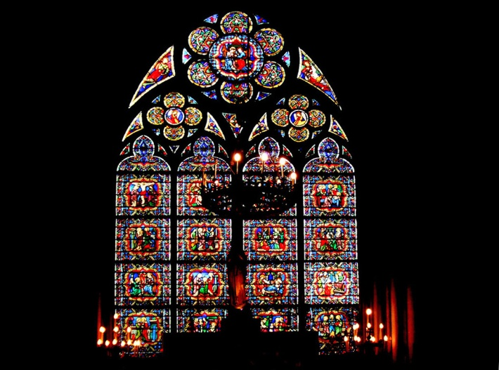
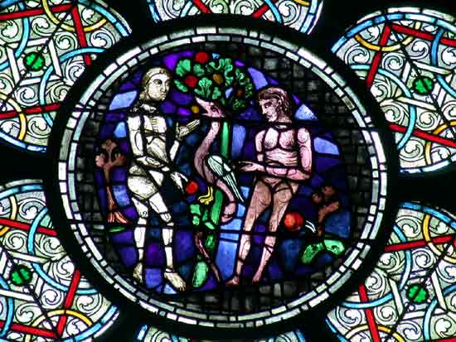
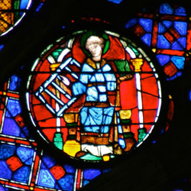
Beautiful Stained Glass

Slide 6
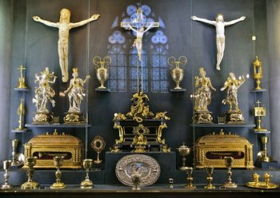
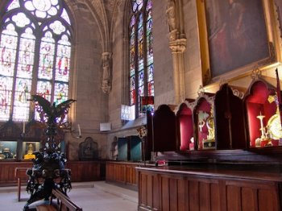
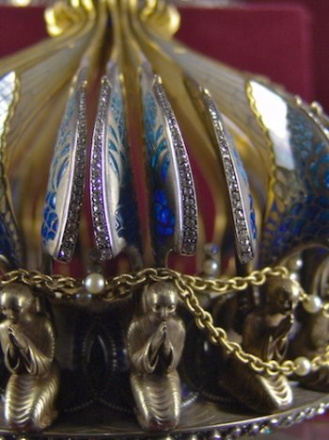
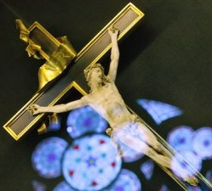
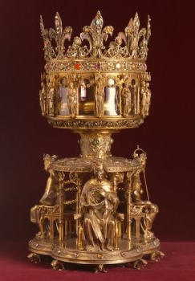
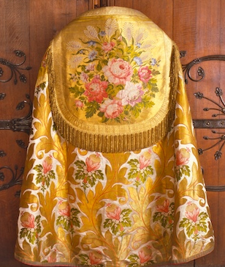
The Treasury
In their treasury they protect and conserve religious objects to preserve their holy nature.
These objects are things like:
-chalices, ciboria, pyxes
-cruets, trays, basins, chrismatories,
-copes, liturgical vestments like albs, stols, historical books.
-items that came in contact with Jesus Christ.

Slide 7
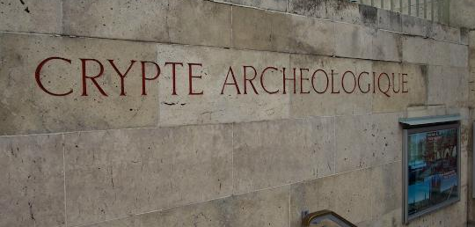
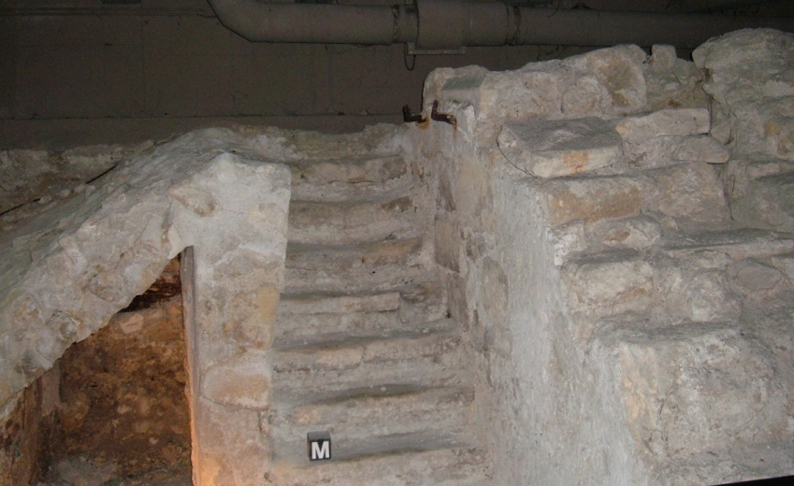
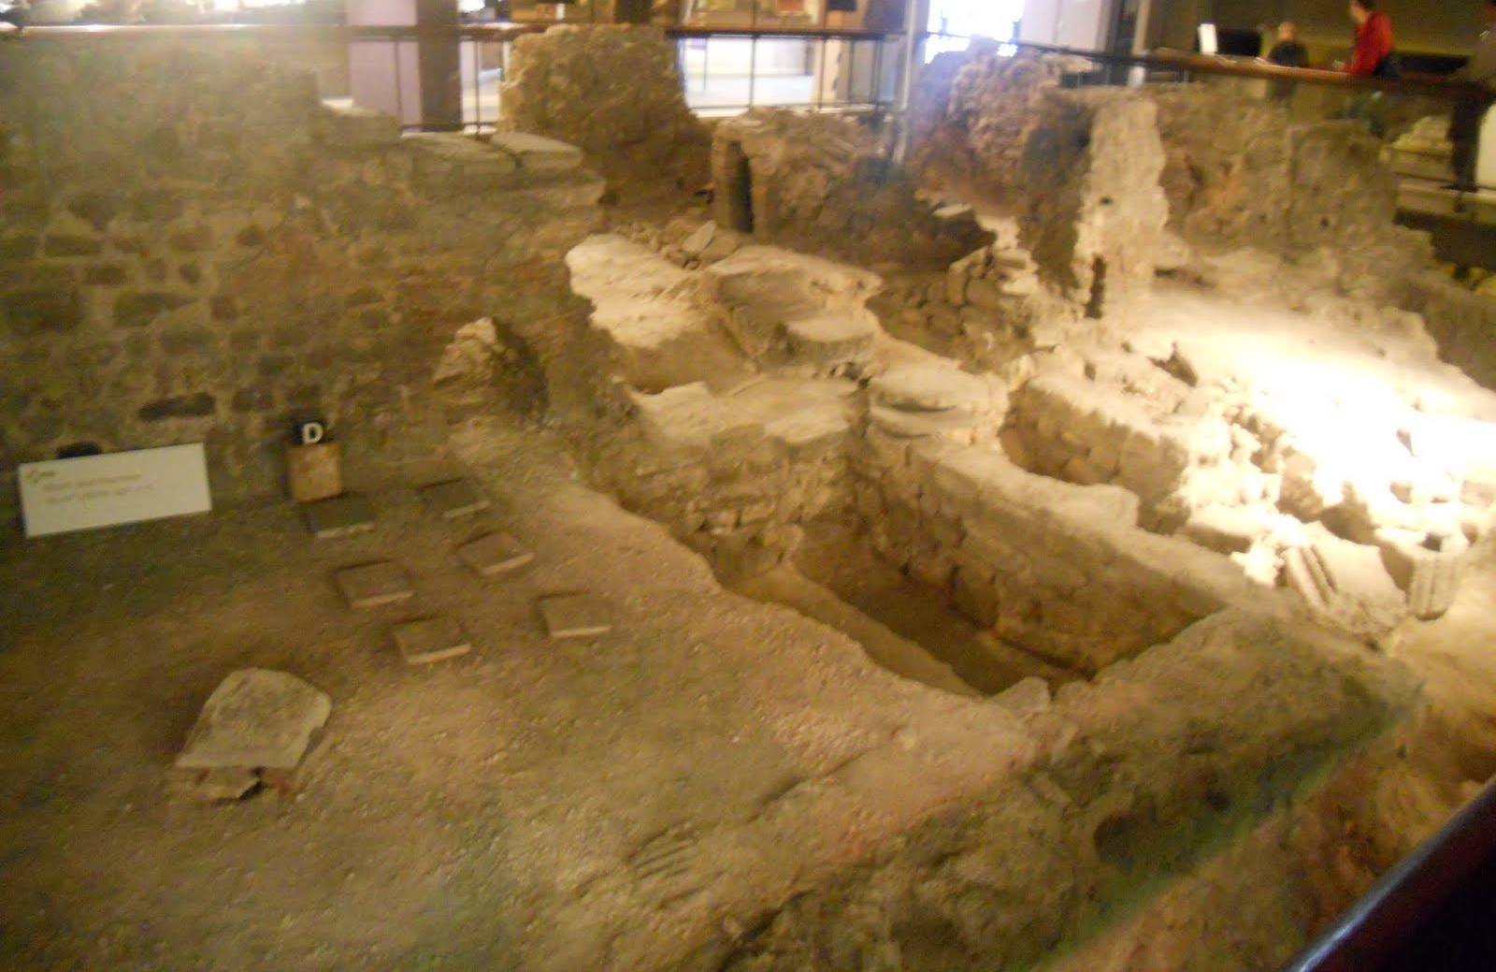
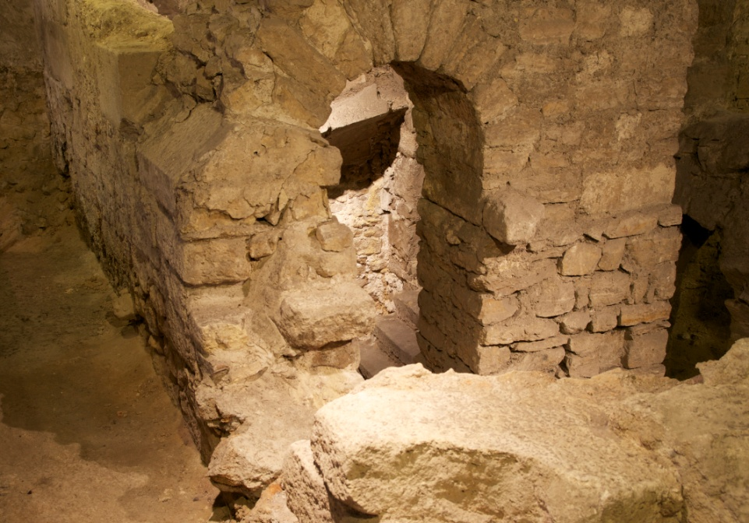
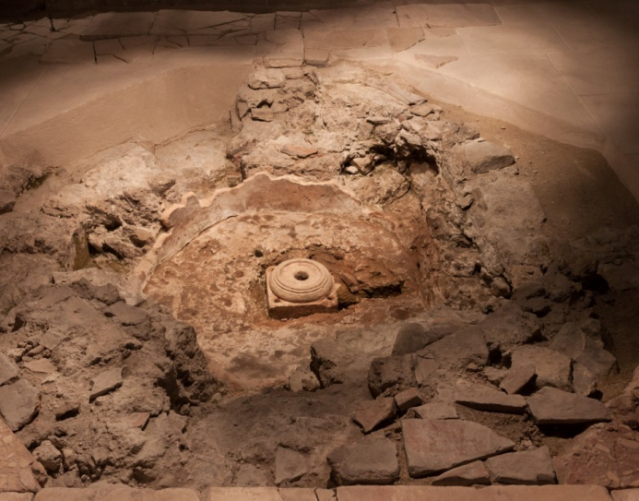
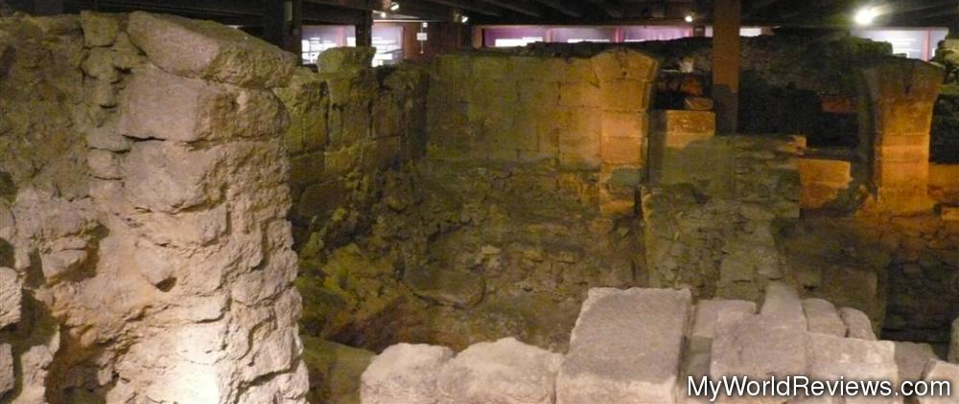
(The Crypt)

Slide 8
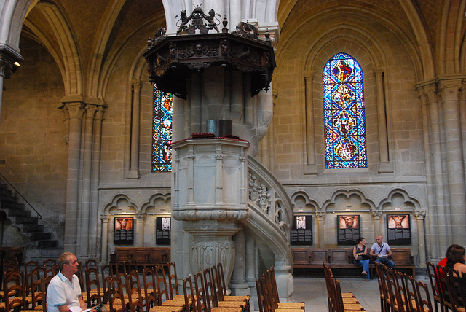
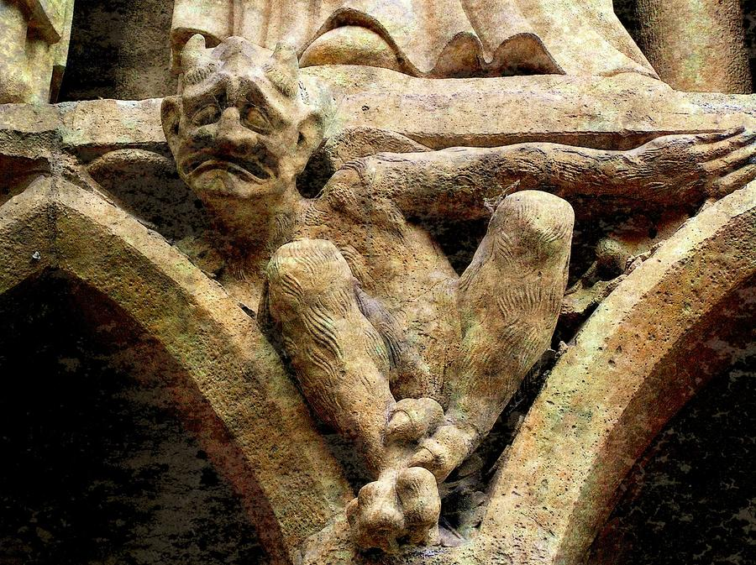
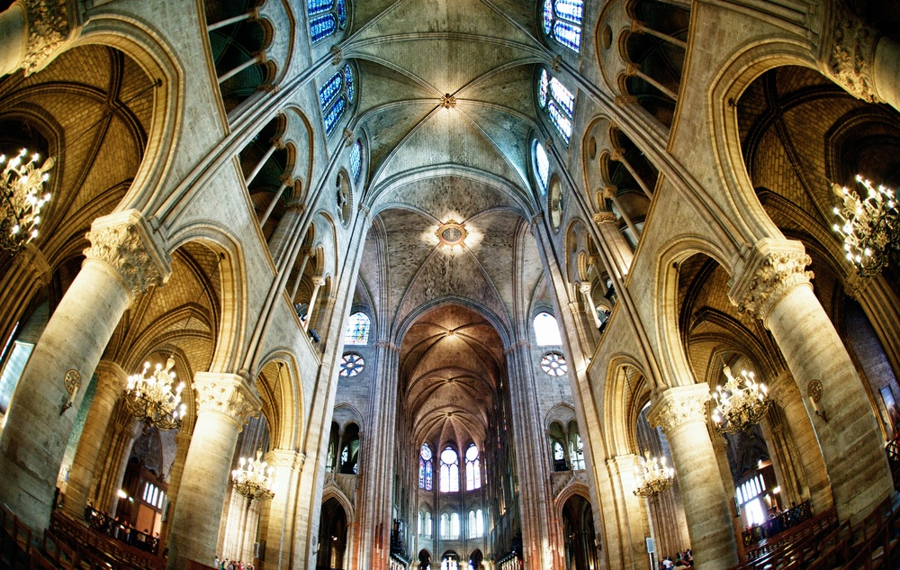
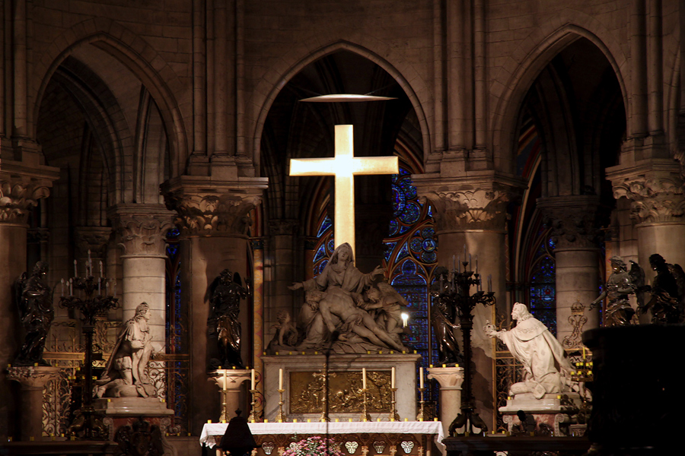
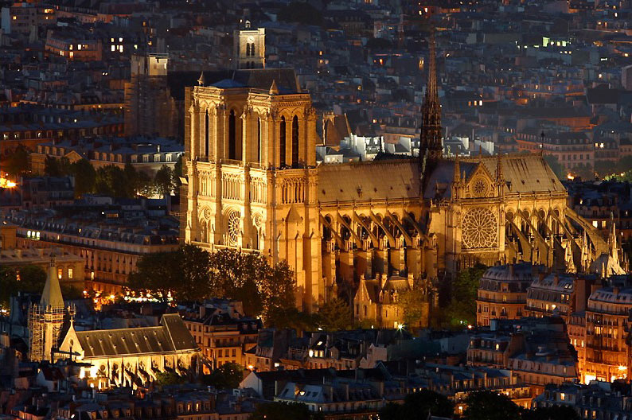
Other Cool Architectures

Slide 9
My Final Thoughts:
I thought this was a really interesting assignment, where I was able to reflect on the different things I learned in class about Cathedrals, and connect them to the architecture of this specific one. What was interesting to me was the features Cathedrals could have, and that they were shown through a bunch of different ones, whereas this Cathedral demonstrates most of them in one place; the gargoyles, the stained glass, the crypt and treasury, the shrine for Mary, the Last Judgement, cruciform, an organ and well known choir, large arches, and a pulpit (although disappointing). It is really old, and has quite the history of how it came to be. I found it really facinating and beautiful, and for once in my life I am excited to go see one ☺
By Leah Hoffman.

Slide 10
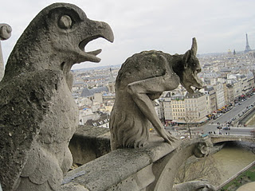
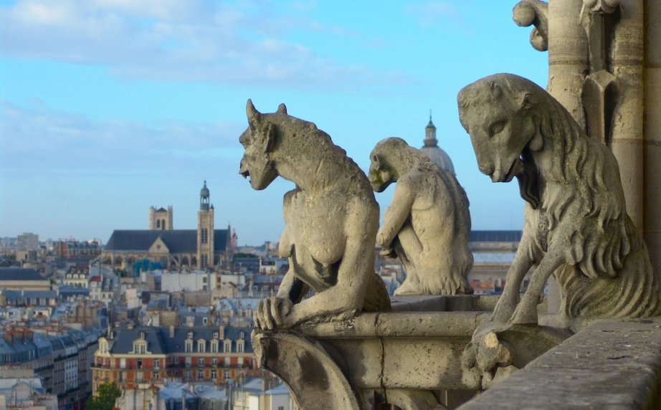
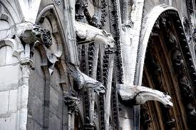
Surprise!
Can’t forget about the SWEET Gargoyles!

