Slide 1
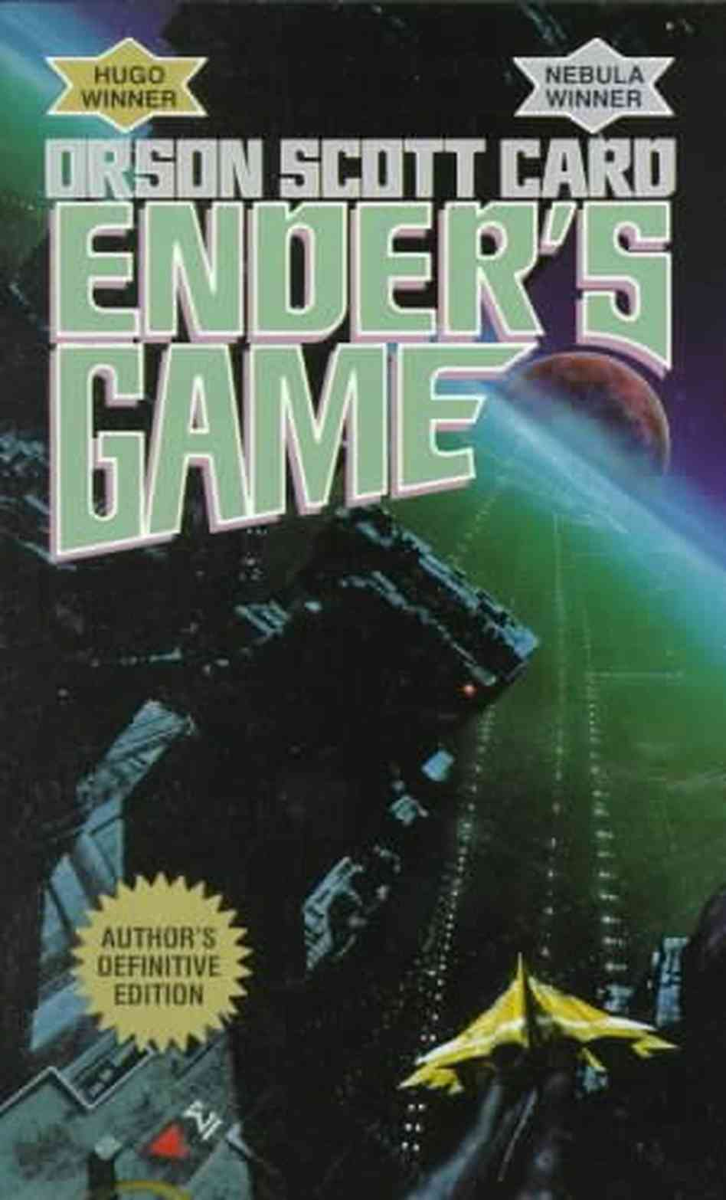
Bugger Wars vs.Holocaust
Comparison of the tragic events and intentions of the Holocaust to Ender and his interactive life with Buggers.

Slide 2
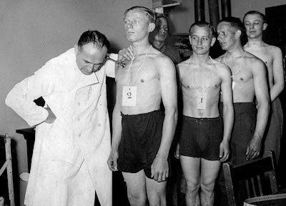
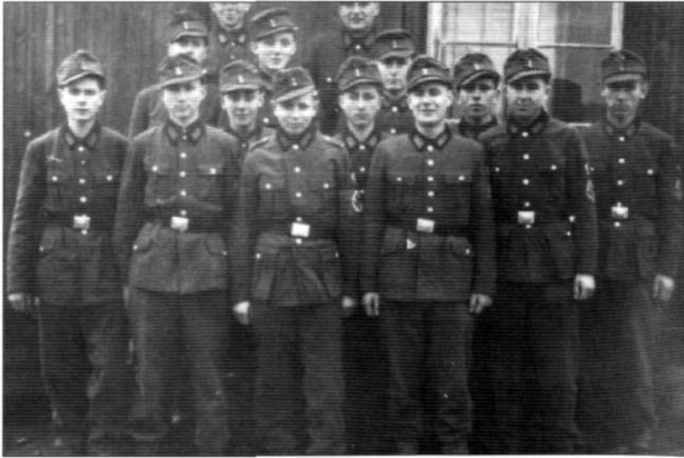
The People Used (nazi’s)
Many Nazi’s were conscripted.
Many joined for adventure, or escape.
Pressure to be a Great German Citizen.
Ordinary doctors, teachers, police, etc.
Mostly strong young men, some too young.
Notes:
Conscription
Made to look like protecting family from evil
Patriotism, national hero

Slide 3
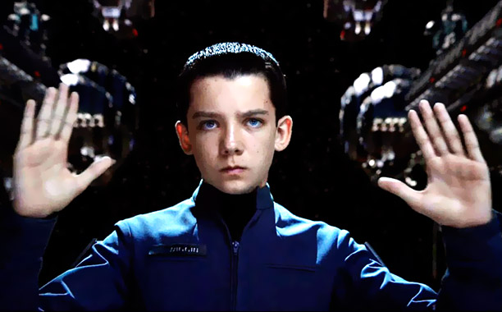
The People Used (battle groups)
SUPER CHILDREN!
Watched by IF with monitors on necks.
Could go even if parents didn’t allow.
“ For the two of you, the choice was already made when Ender was concieved. But for Ender, the choice has not been made at all.”
Notes:
Conscription
Made to look like protecting family from evil
Patriotism, national hero

Slide 4
Comparison of people:
Both watched and made sure they had the ‘right people’ to do what they wanted.
Both categories of people joining the army’s didn’t necessarily have permission.
Both army’s members changed significantly due to the training and battles they endured.
Both appealed to be an opportunity to be a hero.

Slide 5
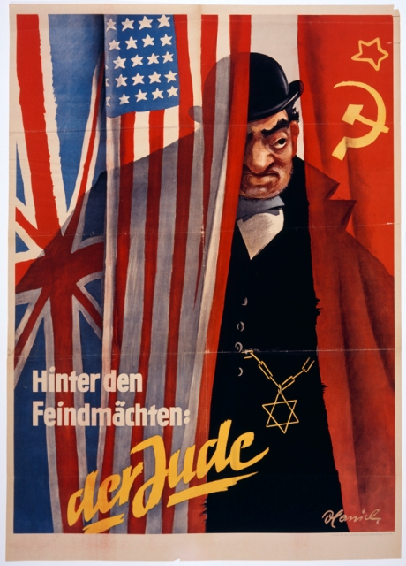
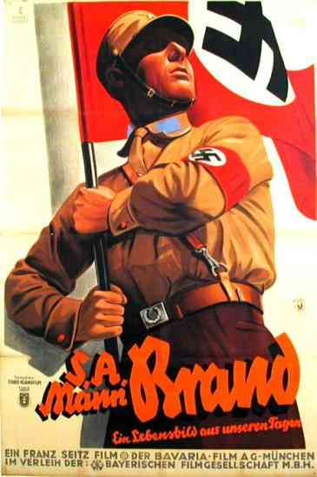
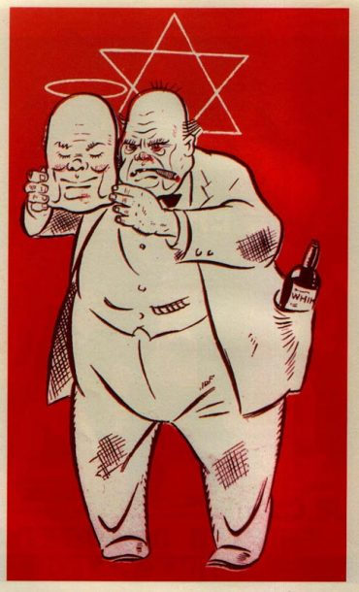
Propaganda (nazi’s) :

Slide 6
Propaganda (Battle school):
“Battle school is for training future star ship captains and commodores of flotillas and admirals of the fleet” –Graff (pg 20)
“ And none have retired from a position of lower rank than chief executive officer of interplanetary vessel.” –Graff (pg 21)
Ender asks” How many make it through the first year”, “all who want to” replied Graff (pg 21)

Slide 7
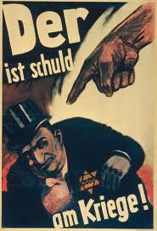
Reasons to invade (jews):
Nazi’s believed Jews were responsible for black plague, and the killing of Jesus.
Judaism was well known and
expanding, became big and
threatening.
Germans are ‘THE PERFECT RACE’.
No imperfections allowed, ie;
Homosexuality, religion, practices,
race, and whatever was disliked.
Notes:
Nazis believing Allies didnt follow rules either,
Jews being hated throughout ever
Jews expanding and larger numbers, feared by German because not “perfect people”

Slide 8
Reasons to invade (buggers):
Buggers attacked previously, why not again?
80 years since last attack, have to be ready for next one, expected anytime.
If the IF attacked first, it would ensure no surprise defeat from the buggers.
No future threats or tension over the buggers
Notes:
Nazis believing Allies didnt follow rules either,
Jews being hated throughout ever
Jews expanding and larger numbers, feared by German because not “perfect people”

Slide 9
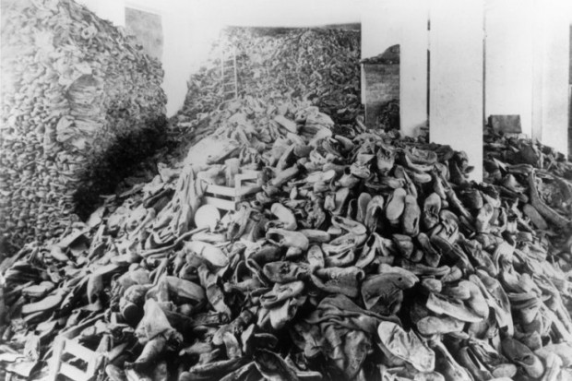
Appearance vs Reality (Jews)
The Jews were simply practicing their beliefs
Wanted to be normal citizens, accepted and treated like everyone else.
Concentration camps
& ghettos were secret.
Numbers were
expanding only because
people were accepting
purity and peace.

Slide 10
Appearance vs Reality (buggers)
-Humans felt threatened by the surprise and numbers of the buggers.
-The war wasn’t a war, but simply Ender quickly killing all the buggers.
-Buggers felt guilty for murdering Humans, never went back.
-Wanted to colonize elsewhere, thought they were the only species.
“When we understood, we never came back”
Notes:
Nations conflicting
Not everyone knew what was happening with the jews
Not everyone knew why

Slide 11
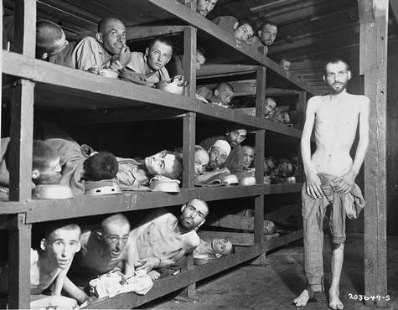
Comparison of A vs R’s:
Both wanted to live in peace and harmony.
Both wanted to be understood of intentions.
Both expanding only for the good, both didn’t know how others would react.
Both worlds had no idea of what was happening.
Notes:
Nations conflicting
Not everyone knew what was happening with the jews
Not everyone knew why

Slide 12
Bibliography:
1. Anderson, Tim. Chapter 3: Prosecution & Defense. Nuremburg Trials. N.p.: n.p., n.d. 3. History Reference Center. Web. 09 Dec. 2013. <http://web.ebscohost.com/hrc/detail?sid=1990100f-a8d1-43f7-9f4f-e79534c80281%40sessionmgr4003&vid=1&hid=4207&bdata=JnNpdGU9aHJjLWxpdmU%3d#db=khh&AN=15315845>.
2. "English Online." Holocaust. N.p., n.d. Web. 09 Dec. 2013. <http://www.english-online.at/history/holocaust/holocaust-mass-murder-of-jews-in-world-war-2.htm>.
3. Parkinson, Roger. The Origins of World War Two. 4th ed. [London]: Wayland, 1987. Print.
4. Gilbert, Martin. The Holocaust: A History of the Jews of Europe during the Second World War. 1st ed. New York: Holt, Rinehart, and Winston, 1986. Print.
5. Card, Orson Scott. Ender's Game. 4th ed. Vol. 1. New York: Tor, 1977, 1985, 1991. Print. Ender's Game Ser.

